Slide 1
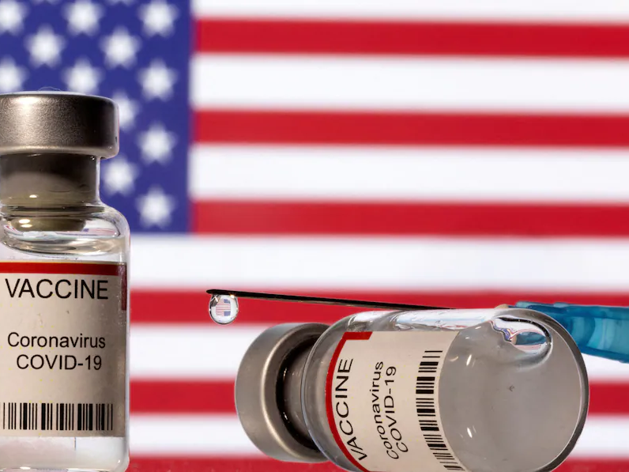
Polarization In COVID-19 Vaccine Discussion Networks
Sharif Amlani and Spencer Kiesel
Ph.D. Candidates; UC Davis
Ross Butters
Adjunct Assistant Professor; University of California Center Sacramento
Christopher Hare
Assistant Professor; UC Davis
samlani@ucdavis.edu; skiesel@ucdavis.edu; rbutters@ucdavis.edu; cdhare@ucdavis.edu

Slide 2
Vaccination in the US
Safe effective vaccines
Virtually guarantee mild COVID
Persistent hesitancy

Slide 3
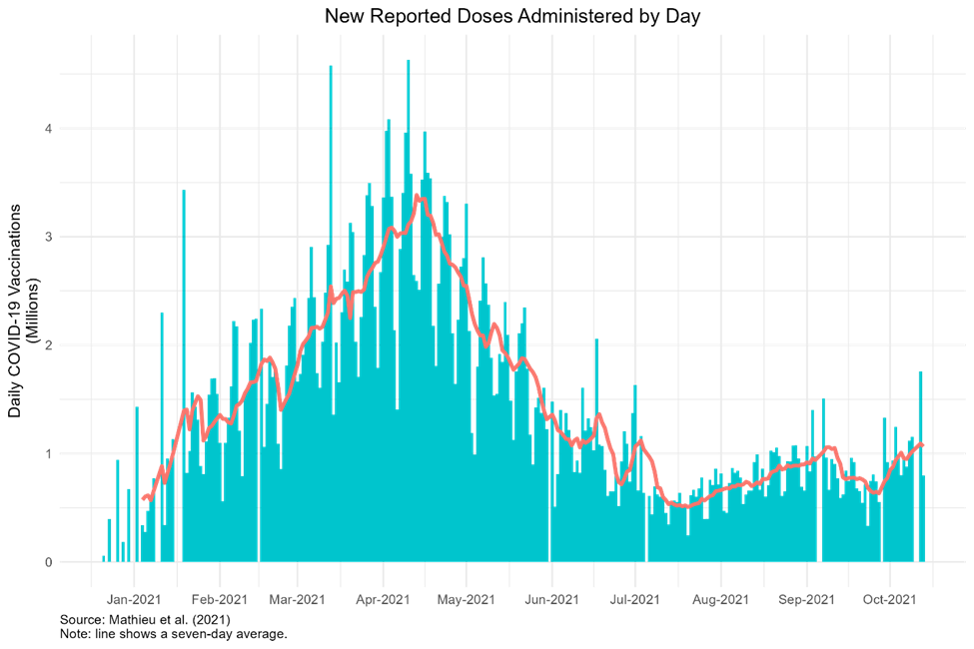
Vaccinations in the US
Figure 1: Distribution of Vaccination Rates Over Time in the United States
April to August collapse

Slide 4
Question
Do the vaccination status and attitudes in an individual’s core social network inhibit or motivate their decision to receive a COIVD-19 vaccine?

Slide 5
Major Take Away
Attitudes about COVID-19 vaccines are polarized by network vaccination levels
Respondents tend to exist in networks polarized by vaccination status
Partisans in vaccinated networks are equally likely to receive a COVID-19 vaccine
Unvaccinated individuals face reinforcing social pressure from their closest associates

Slide 6
Past Research
Individuals rely on a close group to acquire information, formulate opinions (R. Huckfeldt, Johnson, et al., 2004; Sinclair, 2012)
Core networks provide information to shape attitudes and behaviors (Berelson et al., 1954; R. Huckfeldt, Mendez, et al., 2004; Sokhey & McClurg, 2012)
Political topics are discussed largely with like-minded people (Butters & Hare, 2020)

Slide 7
Health Decisions
Vaccines (Bicchieri, 2016; Fishbein & Ajzen, 2011)
Quitting smoking (Christakis & Fowler, 2008)
Dieting (Centola 2011)

Slide 8
Our Contribution
Include COVID-19 vaccination into research on mass political polarization
Apply social network theories to understand whether individuals receive a COVID-19 vaccine, a salient policy issue
Bridge the gap between political behavior and health psychology

Slide 9
Theory
Relevant peers’ choices are informative for helping individuals to judge a behavior’s credibility, feasibility, and social desirability (Christensen et al., 2004; Cialdini, 2007; Paluck et al., 2016)
Network homophily (Konstantinou et al 2021)
Normative social pressure (Christakis & Fowler, 2008)

Slide 10
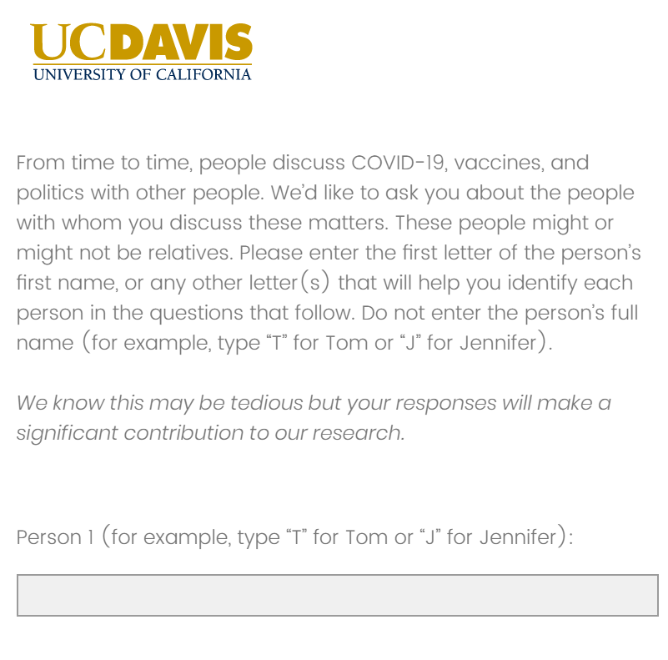
Egocentric Networks
Three discussants
Vaccination status
  Yes or no
  Respondent and discussants
Vaccination attitudes
  Highly resistant to highly supportive
Two waves – pooled
n = 2,560
Notes:
Some suggest that artificially limiting a political name generator may impact the number or type of contacts a respondent reports. However, Eveland et al. (2018) suggest that doing so, “did not prohibit the majority of respondents from reporting as many alters as they were willing.” (p. 194).

Slide 11
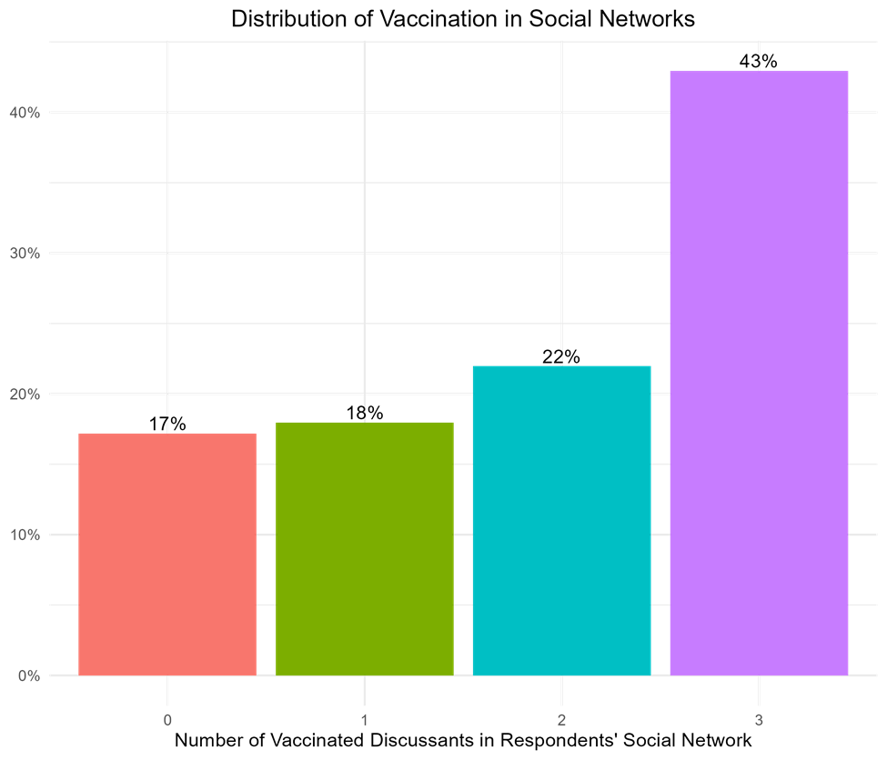
Vaccination rates
Figure 2: Distribution of Vaccination Status in Respondents’ Social Network
IV = number of vaccinated discussants (0-3)
DV = whether respondent received a vaccine (0/1)
Notes:
At the time of survey (July and August 2021), 63.8 (70.4) percent of respondents in wave 1 (wave 2) report receiving a COVID-19 vaccine. Between wave 1 and 2, our sample reports a 6.6 percent increase in vaccinated Americans.

Slide 12
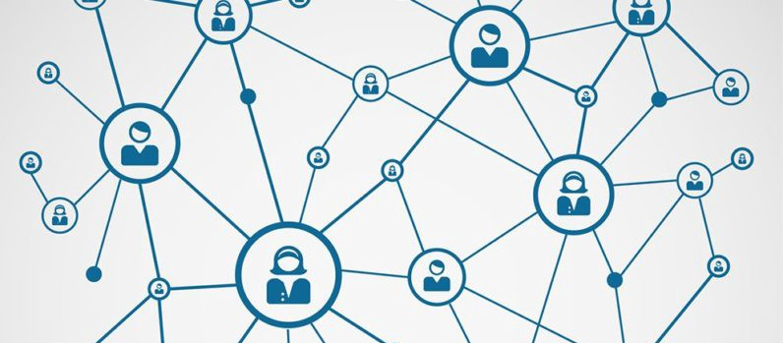
How does an individual’s likelihood of being vaccinated change as their number of vaccinated discussants increases?

Slide 13
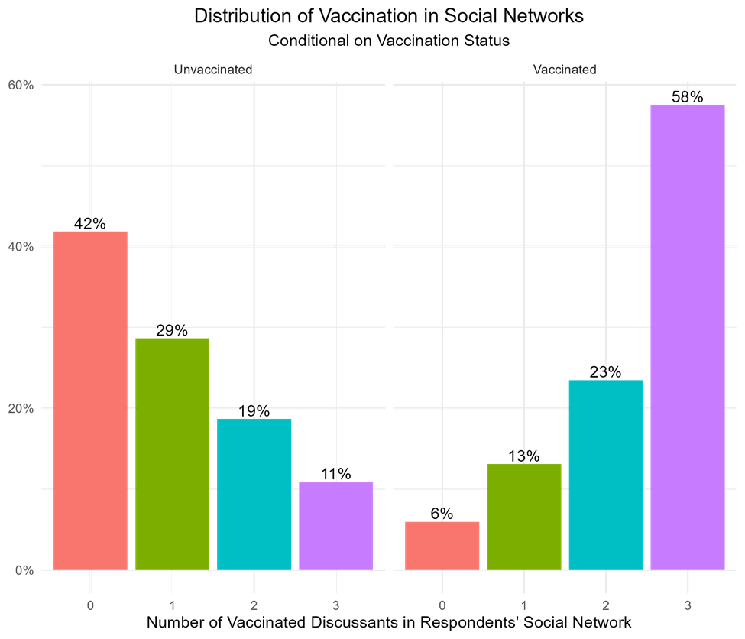
Homogenous social networks
Figure 3: Distribution of Vaccination in Respondents’ Social Network Conditional on Respondents’ Vaccination Status
Discussants’ vaccination status is closely associated with respondents’ vaccination status

Slide 14
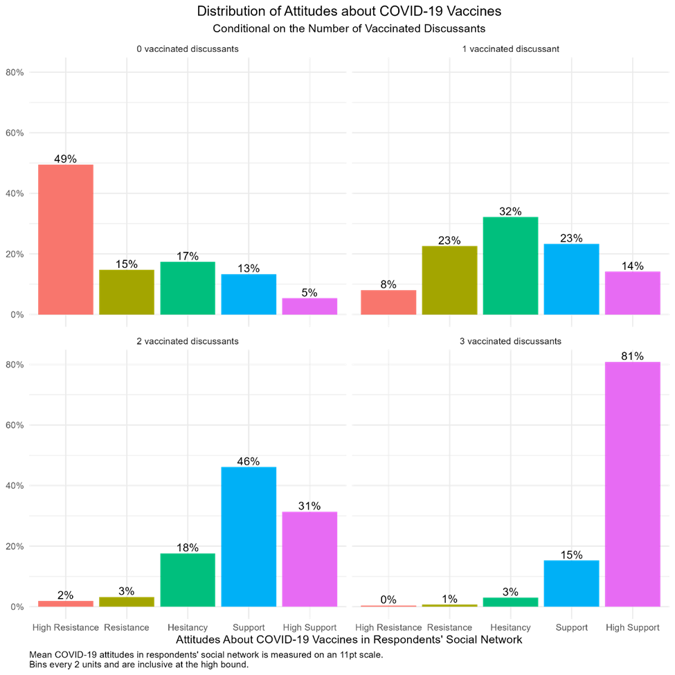
Attitude Polarization
Figure 4: Distribution of Attitudes towards Vaccination in Respondents’ Social Network

Slide 15
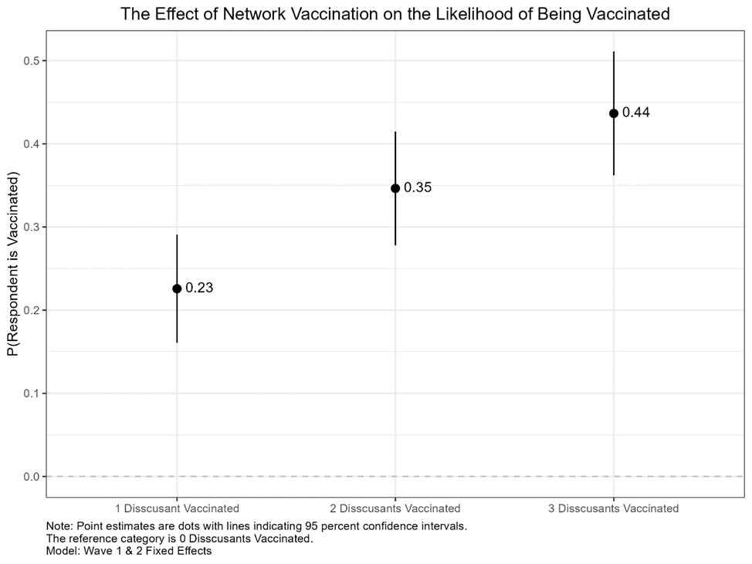
Positive Association
Figure 4: The Effect of Network Vaccination on the Likelihood of Being Vaccinated
Strong relationship between the number of vaccinated discussants and respondents’ vaccination status
Notes:
$$P(Respondent Received a COVID Vaccine)= α+β_{1}\left(Number of Vaccinated Discussants in Respondent′s Social Network\right)+ {β_{i}(X}_{i})+σ_{c}+ ε$$
The additive term, Number of Vaccinated Discussants in Respondent's Social Network, represents our key independent variable. The variable X_i represents our model’s control variables. We control for the average vaccine support in the respondent’s social network, network sophistication, network size, demographic information about the respondent: education level, age, gender, and ethnicity. We also control for political variables, such as their three-point party identification and their political ideology. We control for geography by including county fixed effects to control for fixed observed and unobserved heterogeneity across counties. Lastly, we include a wave fixed effect variable to control for fixed observed and unobserved heterogeneity between survey times.
We interact respondents’ three-point party identification with the number of vaccinated discussants in respondents’ social network. We control for ideology on a 7-point scale, respondents’ education, household income, age, gender, ethnicity, wave fixed effects and county fixed effects. We report the results of the fixed effects model

Slide 16
Partisanship and Vaccination
Remarkably strong association
  Individuals’ network composition
  Vaccination status
Mechanisms?
  Further work
PID?
Widespread findings of polarization in vaccination by PID
  Republican hesitancy
Notes:
Normative social pressure (Christakis & Fowler, 2008)

Slide 17
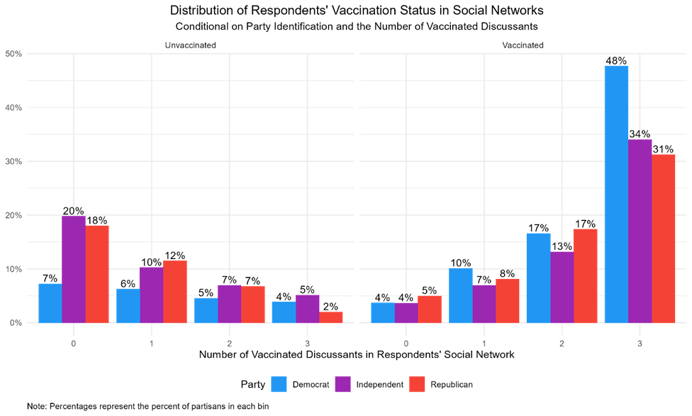
Political Polarization?
Figure 6: Distribution of Vaccination in Respondents’ Social Network Conditional on Respondent’s Vaccination Status Across Partisanship
Network effects function across parties
Notes:
discussants’ vaccination status is associated with increasing vaccination rates, irrespective of party affiliation when partisan have one or two vaccinated discussants. When Republicans and Independents have three vaccinated discussants, the boost they receive makes them just as likely to be vaccinated as Democrats. Together, these finding suggest that the social pressure respondents face may encourage or dissuade vaccination.

Slide 18
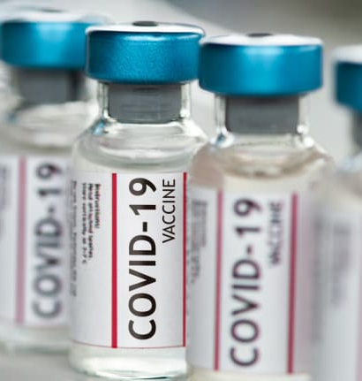
Major Take Always
Attitudes about COVID-19 vaccines are polarized by network vaccination levels
Respondents tend to exist in networks polarized by vaccination status
Partisans in vaccinated networks are equally likely to receive a COVID-19 vaccine
Unvaccinated individuals face reinforcing social pressure from their closest associates

Slide 19

Questions
How serious an inhibitor to publication is the endogeneity?
Recommended journals?
Frame as competing hypothesis?

Slide 20

Thank You
Sharif Amlani and Spencer Kiesel
Ph.D. Candidates; UC Davis
Ross Butters
Adjunct Assistant Professor; University of California Center Sacramento
samlani@ucdavis.edu; skiesel@ucdavis.edu; rbutters@ucdavis.edu

Slide 21
Appendix

Slide 22
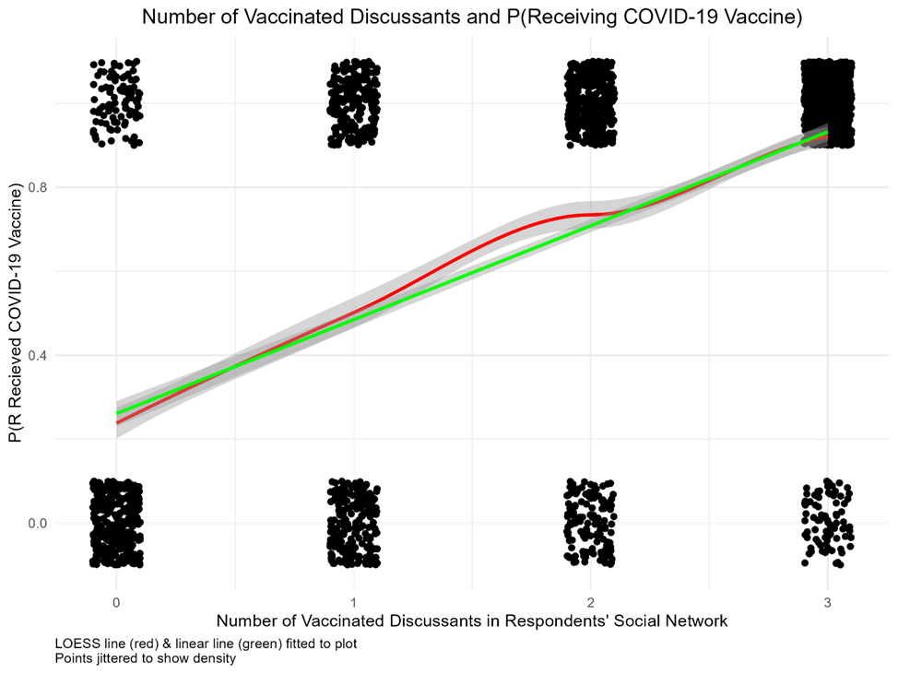
Nearly Linear Effects
Figure 5: Functional Form of the Probability the Respondent being Vaccination as a function of the Number of Vaccinated People in Respondents’ Social Network
Notes:
We interact respondents’ three-point party identification with the number of vaccinated discussants in respondents’ social network. We control for ideology on a 7-point scale, respondents’ education, household income, age, gender, ethnicity, wave fixed effects and county fixed effects. We report the results of the fixed effects model

Slide 23
Results
Figure x:
stuff

Slide 24
Results
Figure x:
stuff

Slide 25
Results
Figure x:
stuff

Slide 26
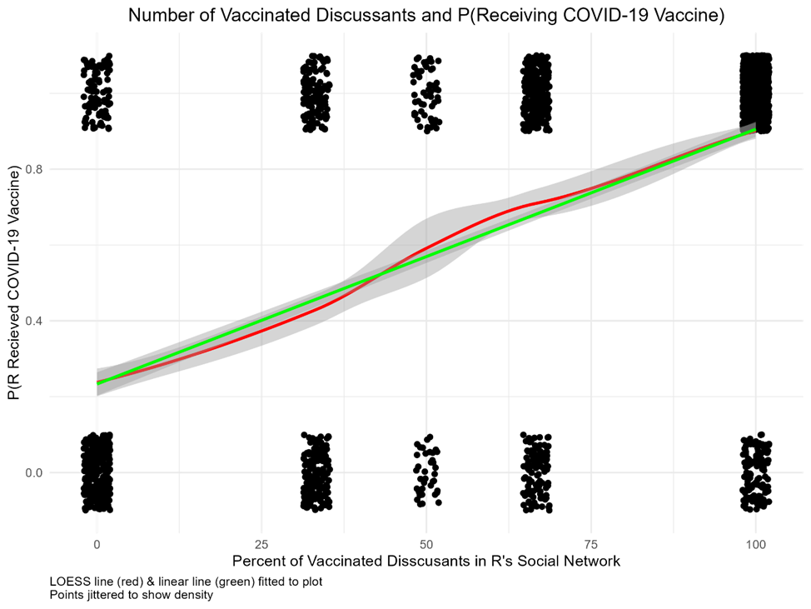
Model with percent vaccinated
Figure x: Functional Form of the Probability the Respondent being Vaccination as a function of the Percentage of Vaccinated People in Respondents’ Social Network
stuff

Slide 27
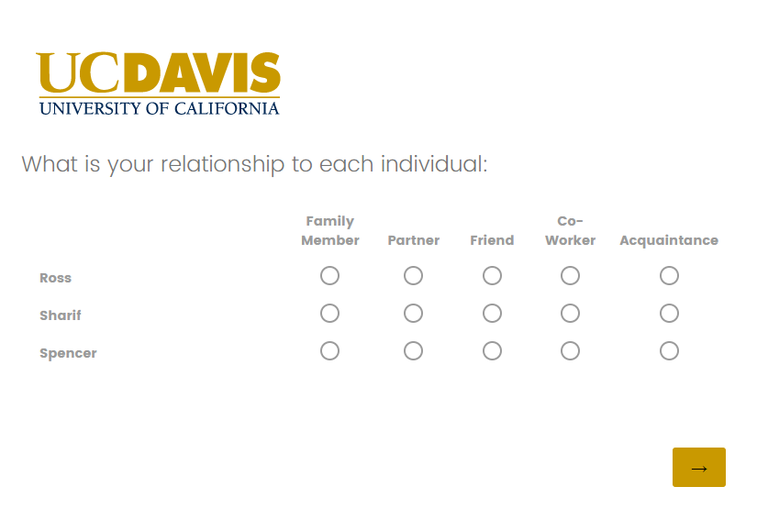
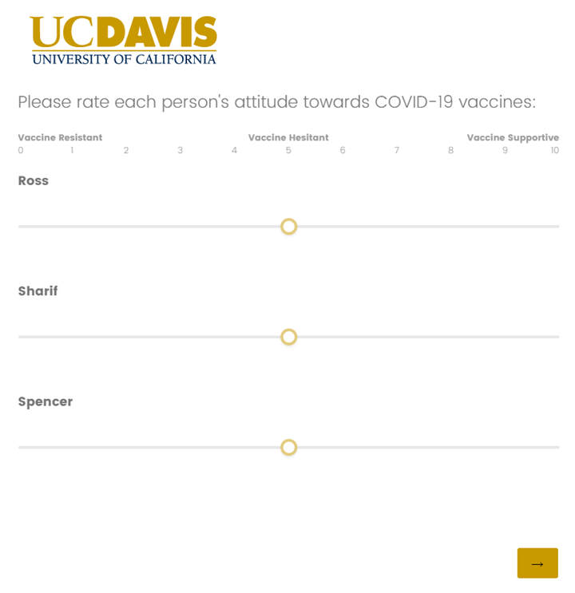
Survey Items

