Slide 1
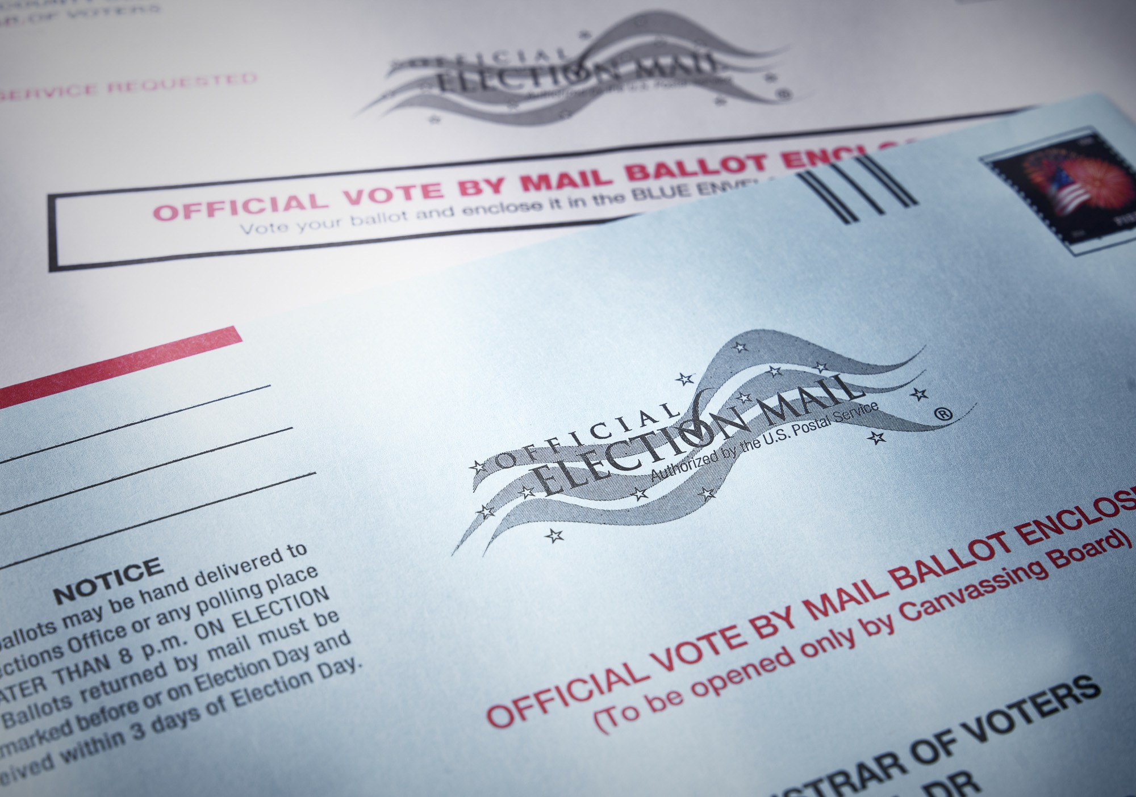
The Impact of Vote-By-Mail Policy on Turnout and Vote Share in the 2020 Election
Sharif Amlani and Samuel Collitt
Ph.D. Candidates
Department of Political Science
UC Davis
samlani@ucdavis.edu; sccollitt@ucdavis.edu
Notes:
Rocca Smile
Good Afternoon everyone. It is a pleasure to be with you today. The name of our paper is…

Slide 2
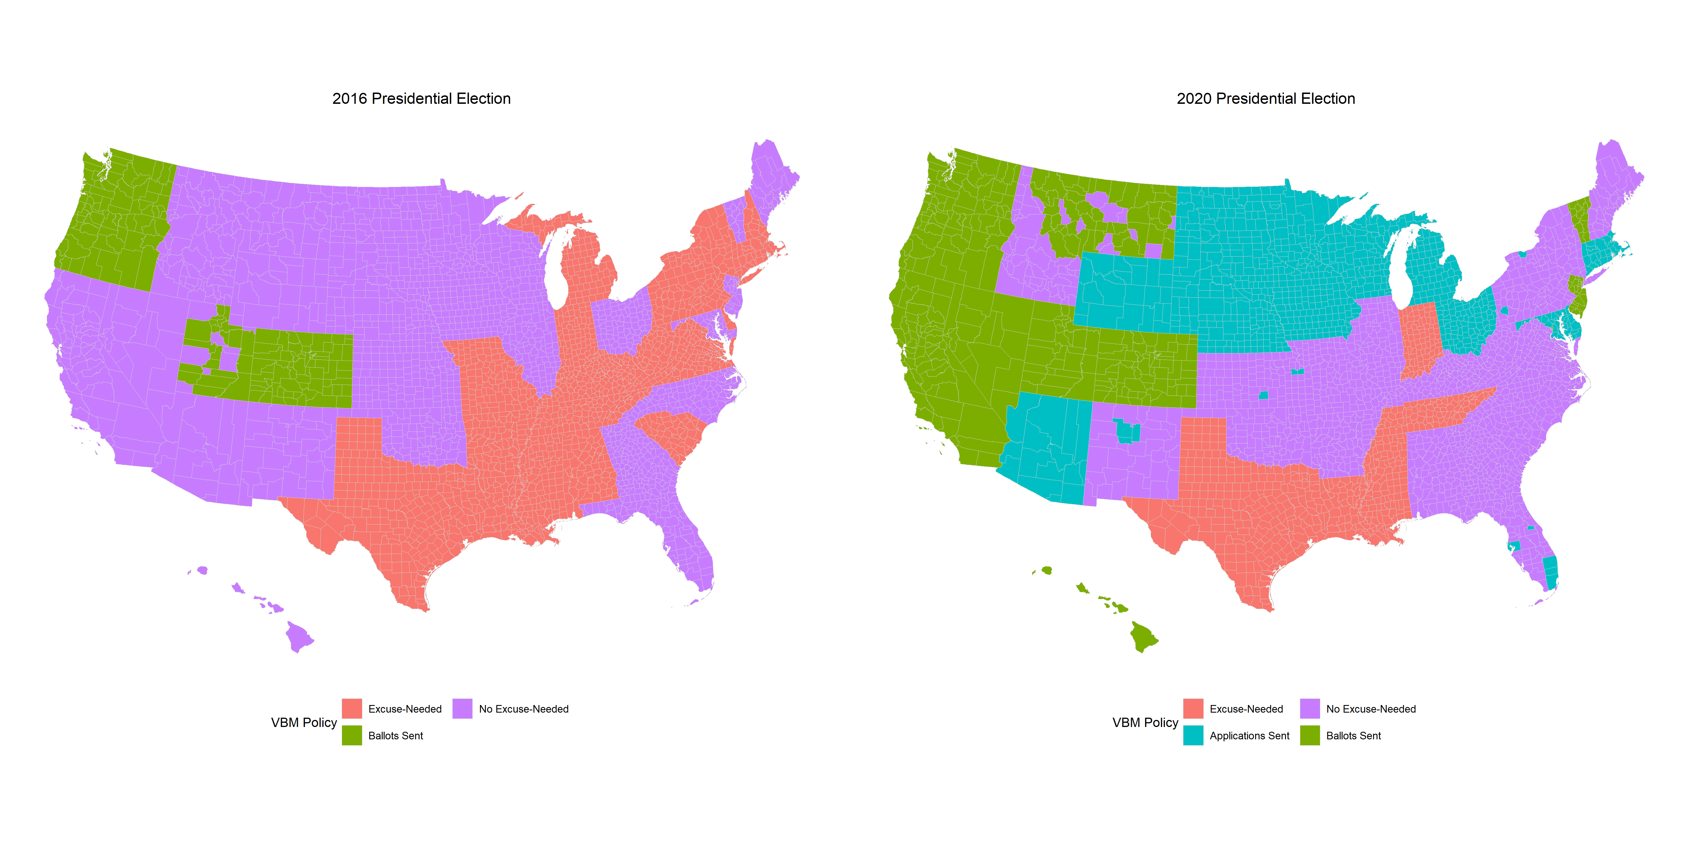
The 2020 Election
In response to the COVID-19 pandemic, many states and counties changed their policy making it easier to vote-by-mail.
Notes:
In response to the COVID-19 pandemic, many states and counties changed their voting policy making it easier for their citizens to vote-by-mail.
The degree to which they made it easier varied considerably.
Record number of counties sent ballots to voters for the first time.
Counties also introduced no-excuse VBM applications, which was unavailable in previous elections.
Only 5 states, TX, LA, MS, TN and Indiana chose to continue using, the most restrictive policy, excuse-needed VBM.

Slide 3
The 2020 Election
“The 2020 Election will be totally rigged if Mail-In Voting is allowed to take place & everyone knows it” – President Donald Trump. July 21, 2020
This change created controversy over to what extent VBM policy would affect turnout and vote share.
Notes:
Mail-in Ballots Were Characterized by Donald Trump as…
“a sick joke!”
“Madness!”
“Disaster in the wings!”
“a great embarrassment to the USA”
“dangerous”
“disastrous”
“a total mess”
“stupid”

Slide 4
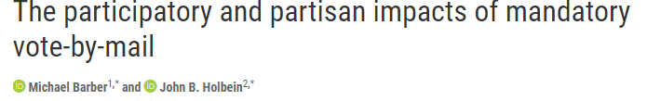
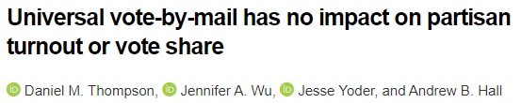
The 2020 Election
Scholars responded with studies citing that automatically sending ballots to voters increases turnout without conferring a partisan advantage
(Barber and Holbein 2020; Thompson et al. 2020).
Notes:
But no study has yet to examine these claims when using data from 2020 election, especially since so many counties changed their VBM policy.

Slide 5
Question
How did turnout change as a function of making voting by mail easier in 2020 election?
Was there was a partisan electoral advantage from doing so?

Slide 6
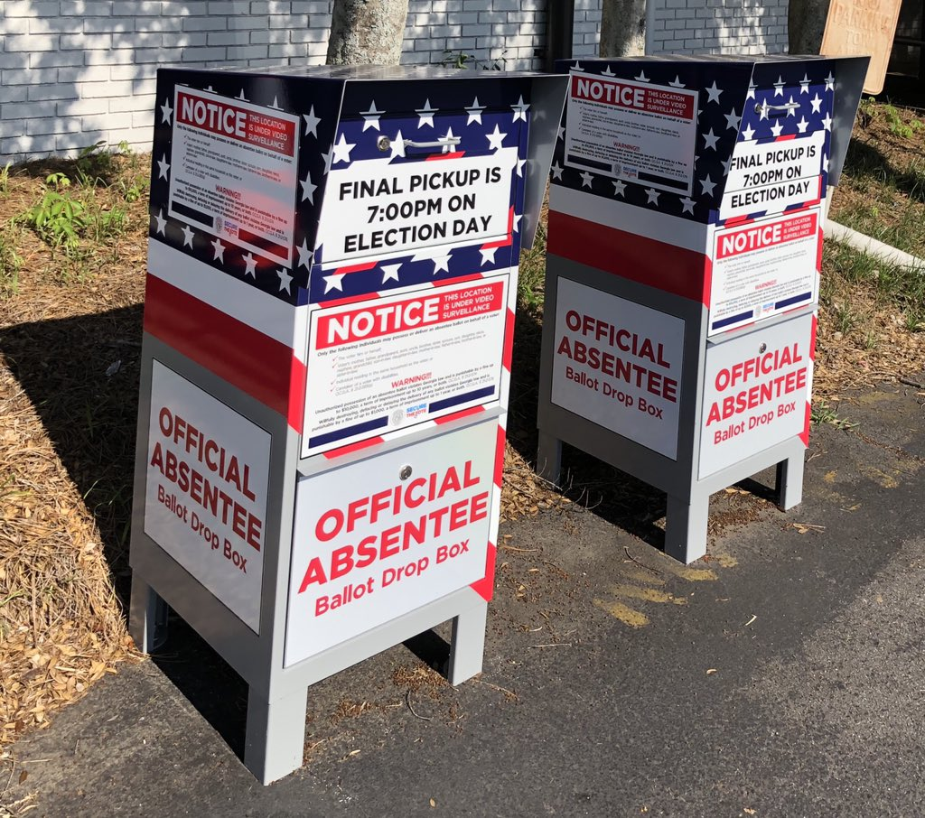
Major Take Away
Automatically sending voters a ballot in the mail produces the highest change in turnout.
Irrespective of the change to policy, we find no evidence of a partisan advantage associated with making VBM easier.

Slide 7
Unique Opportunities in 2020
VBM policy changes in 2020 allows us to examine the effect of changes across an array of policy changes.
Allows us to examine the affects of VBM policy changes on vote share.
Counties whose policies did not change allows us to examine causal effects of VBM changes via a difference-in-difference design.
Relative to past studies that were limited in policy type and geographic location
Notes:
The 2020 election presents three unique opportunities for contributions to the VBM literature.
VBM policy changes in 2020 allows us to examine the effect of a variety policy changes on turnout
These same changes to VBM policy allows us to test whether the various VBM policy changes confer a partisan advantage.
Counties whose policies did not change allows us to examine causal effects of VBM changes via a difference-in-difference design in a nationwide study.
These three point are relative to past studies, that are limited in the policy type they examine, and the # of states and counties included in their sample.

Slide 8
Hypothesis
Consistent with the literature, we hypothesize that making voting easier, by liberalizing VBM policy, increases turnout.
We hypothesize a higher dosage of VBM policy liberalization leads to proportionately higher turnout.
We hypothesize that easing VBM restrictions does not confer an electoral partisan advantage.
Notes:
Hypothesis are based on the intuition that increasing access to voting, lowers its associated costs (relative to the benefits) making it more likely for people to vote.
The more significant the change in increasing access to VBM ballots, the higher the turnout.

Slide 9
VBM Policy in the 2016 and 2020 Election
Table 1: Joint Distribution of Vote-by-Mail Policies in 2016 and 2020 across counties.
 | 2020 VBM Policies
2016 VBM Policies | Excuse-Needed | No Excuse -Needed | Applications Sent | Ballots Sent
Excuse-Needed | 19% (587) | 24% (748) | 4% (115) | 0% (0)
No Excuse-Needed | 0% (0) | 23% (702) | 20% (632) | 5% (169)
Ballots Sent | 0% (0) | 0% (0) | 0% (0) | 5% (160)
Note: Cell entries report the percentage (and number) of counties in each category.
Notes:
The first table reports the Joint Distribution of VBM policies in US counties.
The rows represent VBM policy in 2016 ranging from excuse needed absentee, no-excuse needed absentee, and automatically sending voters a ballot in the mail.
The columns represent VBM policy in 2020 ranging from excused needed absentee, no-excuse needed absentee, automatically sending VBM applications to voters, and automatically sending voters a ballot in the mail.
The elements represent the proportion and number of counties in each cross sections.
The red squares represent the proportion of counties that did not change their VBM policy between 2016 and 2020
The green squares represent the proportion of counties that did change their VBM policy between 2016 and 2020
Both show a healthy variation in policies that changed and policies that did not.

Slide 10
Difference-in-Difference Design
Unit: US Counties
Independent Variable:
  The relative change in VBM Policy between 2016 and 2020
    For example, in 2016, Yolo County CA used absentee no excuse and in 2020 it changed to automatically sending voters mail-in ballots.
    Coded: No Excuse-Needed to Ballot Sent
  We use counties who did not change their VBM policy in 2020 as the control condition.
Dependent Variables:
  VAP Turnout
  Republican Presidential Vote Share
Model Specifications:
  Base, Control, County FE, County FE with State Clustered SE
We report the interaction coefficient (i.e., DID estimator)
Table 2: Treatment Conditions in DID Models
Treatment Conditions | Total
Control | 46.55% (1449)
Excuse-Needed to No Excuse-Needed | 24.03% (748)
No Excuse-Needed to Applications Sent | 20.30% (632)
Excuse-Needed to Applications Sent | 3.69% (115)
No Excuse-Needed to Ballot Sent | 5.43% (169)
Total | 100.00% (3113)
Note: Cell entries report the percentage (and number) of counties in each category.
Notes:
Table 2 shows the distribution of our treatment conditions
Turnout data gathered from Dave Leip's Atlas of U.S. Elections.
Control variables for turnout analysis: Democratic vote share, average daily change in COVID-19 deaths per 100,000 people one week before the election, percentage of African Americans, median household income, median age, and percentage of individuals with only a high school diploma.
Control variables for vote share analysis: population density, unemployment rate one month before Election Day, average daily change in COVID-19 deaths per 100,000 people one week before the election, the percent of the county’s population with a high school degree, bachelor’s degrees, the percent of the county that is Black, multiracial, Latino, and foreign-born.
The results in the next slide report the County FE with State Clustered FE model. Full tables are reported in the appendix. Results are consistent across model specification.

Slide 11
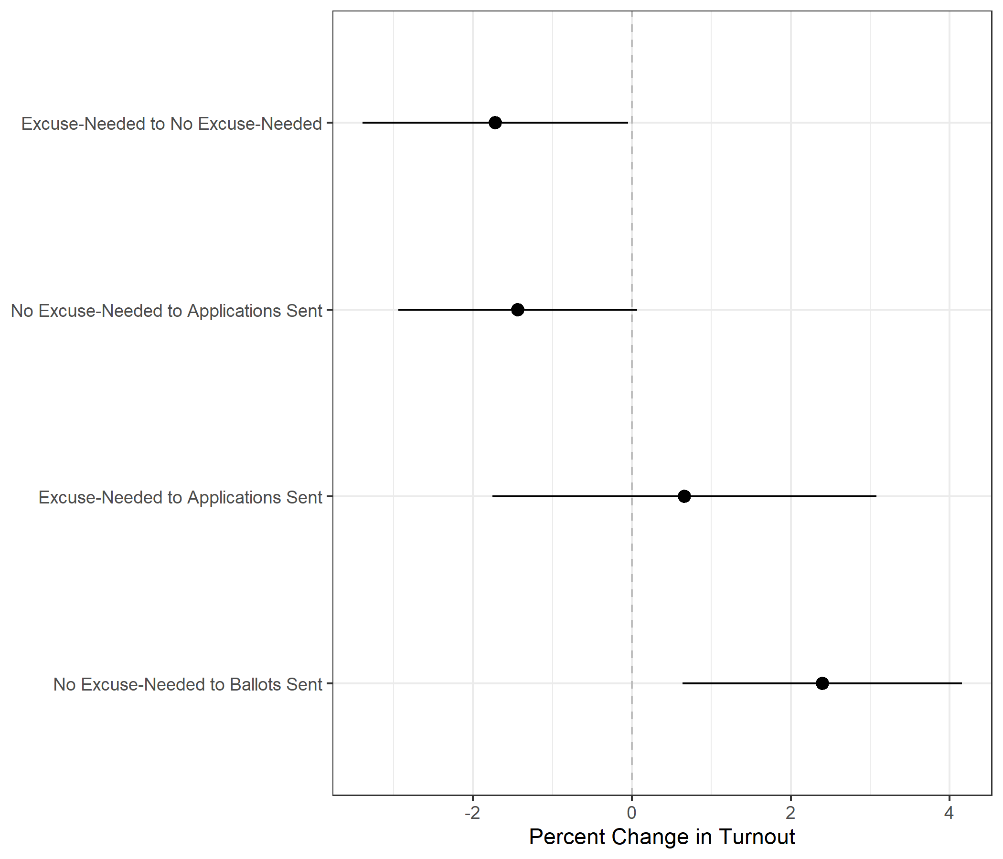
Turnout Results
Figure 1: Difference-in-Difference Estimates of the Effects of the Vote-By-Mail Conditions on Turnout
Turnout in control group was 5.3% higher on average in 2020 than 2016.
Notes:
The change in turnout among the two groups of counties that changed their VBM policy to sending applications did not significantly differ (p > 0.05) from the control group.
Turnout in counties that changed their VBM policy to no excuse-needed was 1.7% lower than the control group (p < 0.05), yielding a net gain in turnout of 3.6% from 2016.
Turnout in counties that changed their VBM policy to ballots sent was 2.4% higher than the control group (p < 0.05), yielding a net gain in turnout of 7.7% from 2016.
Substantively, this means not all liberalizing changes in VBM policy produce higher turnout, we find only changes in policy that send ballots automatically to voters experience a higher change in turnout in the following election.

Slide 12
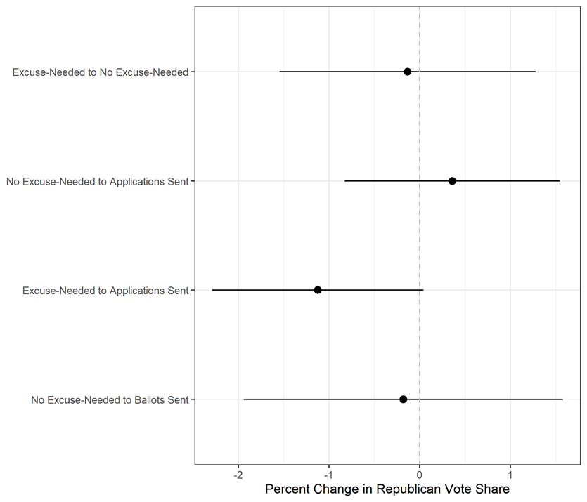
Vote Share Results
Figure 2: Difference-in-Difference Estimates of the Effect of the Vote-By-Mail Conditions on Two-Party Republican Vote Share
Changes to any policy that makes VBM easier does not hurt or help a party at the ballot box.
Notes:
Republican vote share in each treatment group does not deviate from the control in a statistically significant manner.
Changes to any policy that makes VBM easier does not hurt or help a party at the ballot box.

Slide 13
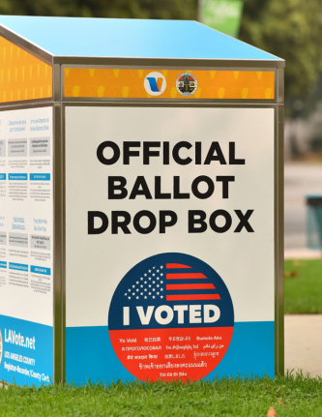
Conclusion
To improve the quality of democracy, sending voters a mail-in ballot produces higher turnout.
Other changes to VBM policy do not noticeably increase turnout.
Regardless of VBM policy change, no partisan advantage is detected.
Our results affirm previous scholarship conducted before the election and rejects elite discourse inditing VBM elections.
Notes:
Our results lead us to the following conclusions:
To improve the quality of democracy, our results suggest that states and counties should automatically send voters a mail-in ballot since it produces the highest increases in turnout .
Other changes to VBM policy do not noticeably increase turnout, and in one case reduce it.
Research suggests that giving people more time to vote can reduce turnout because voters may be less likely to receive reminders and efforts to mobilize voters are dispersed over a longer time – reducing effectiveness
Regardless of VBM policy change, no partisan advantage is detected.
Our results affirm previous scholarship conducted before the election and rejects elite discourse inditing VBM elections.

Slide 14
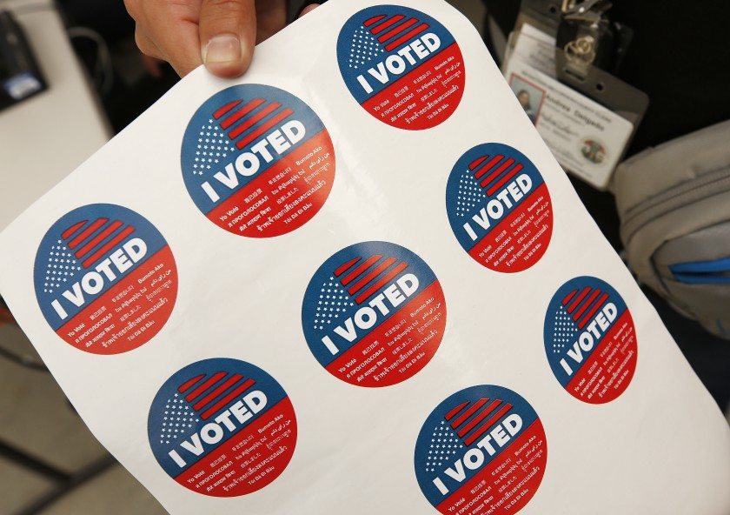
Thank You
Sharif Amlani and Samuel Collitt
Ph.D. Candidates
Department of Political Science
UC Davis
samlani@ucdavis.edu; sccollitt@ucdavis.edu

Slide 15
Appendix

Slide 16
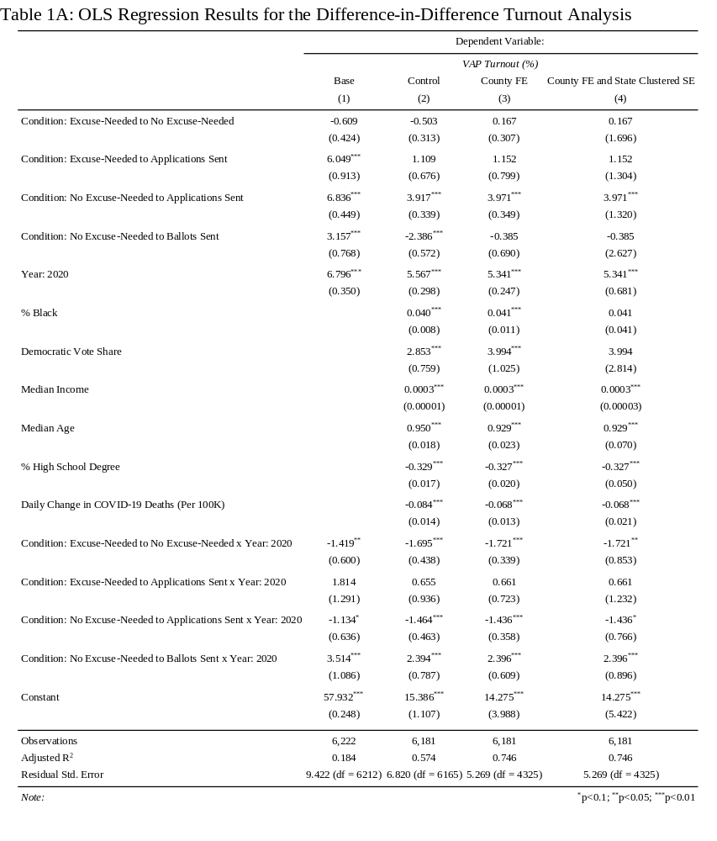

Slide 17
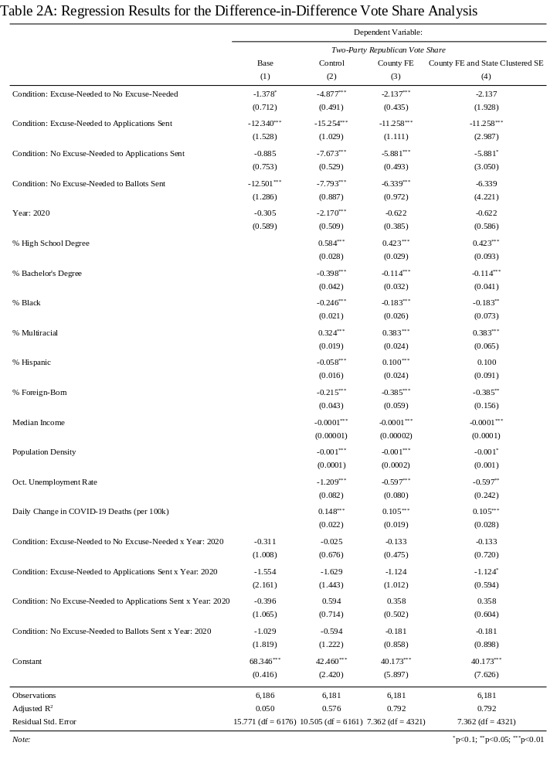

Slide 18
The 2020 Election
Notes:
In response to the COVID-19 pandemic, many states and counties made it easier to vote-by-mail. The degree to which they made it easier varied considerably. We use a difference-in-difference (DID) design to estimate the effects of changes to VBM policy on turnout and then assess their partisan consequences

